Slide 1

Artificial Intelligence
COMP 7720
Fall 2024
Project: House Price Prediction
Group:Reg03
Dundi Sandeep Daddala Neehanth Reddy M
Manideep Reddy J
Instructor: Haomiao Ni, Ph.D.

Slide 2
Introduction
Project: House Price Prediction using Ames Housing Dataset
Goal: Predict house prices using various regression models
Dataset: train.csv (1460 samples) and test.csv (1459 samples)

Slide 3
Data Preprocessing
Feature categorization:Categorical: <20 unique values(Handled with one-hot encoding) (e.g., MSZoning, Street, LotShape)
Numerical: ≥20 unique values (e.g., LotFrontage, LotArea, YearBuilt)
Missing value handling:LotFrontage: Linear interpolation
<400 missing: Most frequent value
>400 missing: Label Encoding

Slide 4
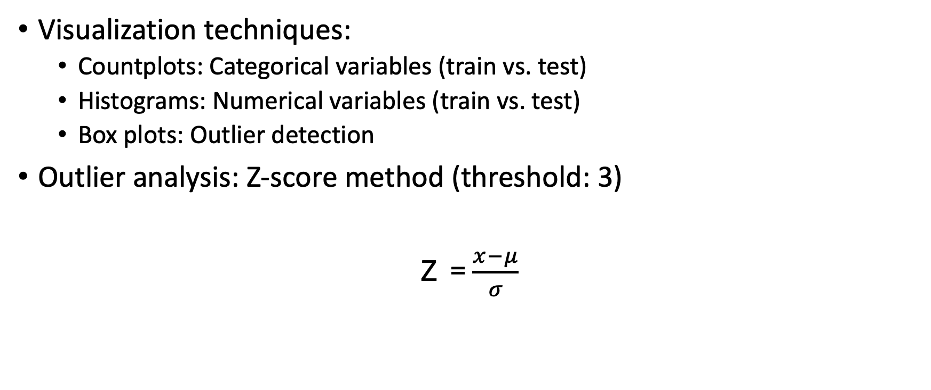
Exploratory Data Analysis
Visualization techniques:
Countplots: Categorical variables (train vs. test)
Histograms: Numerical variables (train vs. test)
Box plots: Outlier detection
Outlier analysis: Z-score method (threshold: 3)
Z = $\frac{x−μ}{σ}$

Slide 5
Feature Importance
Correlation analysis with SalePrice
Top positively correlated features:
OverallQual
GrLivArea
GarageCars
Top negatively correlated features:
KitchenAbvGr
EnclosedPorch
MSSubClass

Slide 6
Feature Relationships
Scatter plots with regression lines: Numerical features vs. SalePrice
Key insights:
Strong positive correlation: OverallQual, GrLivArea, GarageCars
Moderate positive correlation: TotalBsmtSF, 1stFlrSF, FullBath
Weak or no correlation: MSSubClass, OverallCond, YrSold

Slide 7
Model Selection and Training
Target variable: Log-transformed SalePrice
Train-test split: 80-20 (random_state=42)
Models implemented:
Linear Regression
Ridge Regression
Lasso Regression
ElasticNet
K-Nearest Neighbors
Random Forest
Support Vector Regression
Gradient Boosting Regression

Slide 8
Model Evaluation
Metric: Root Mean Squared Error (RMSE)
Model | RMSE
Ridge | 0.1261
Linear Regression | 0.1263
Gradient Boosting | 0.1287
Random Forest | 0.1403
ElasticNet | 0.1764
Lasso | 0.1835
SVR | 0.2032
KNN | 0.2123

